Slide 1

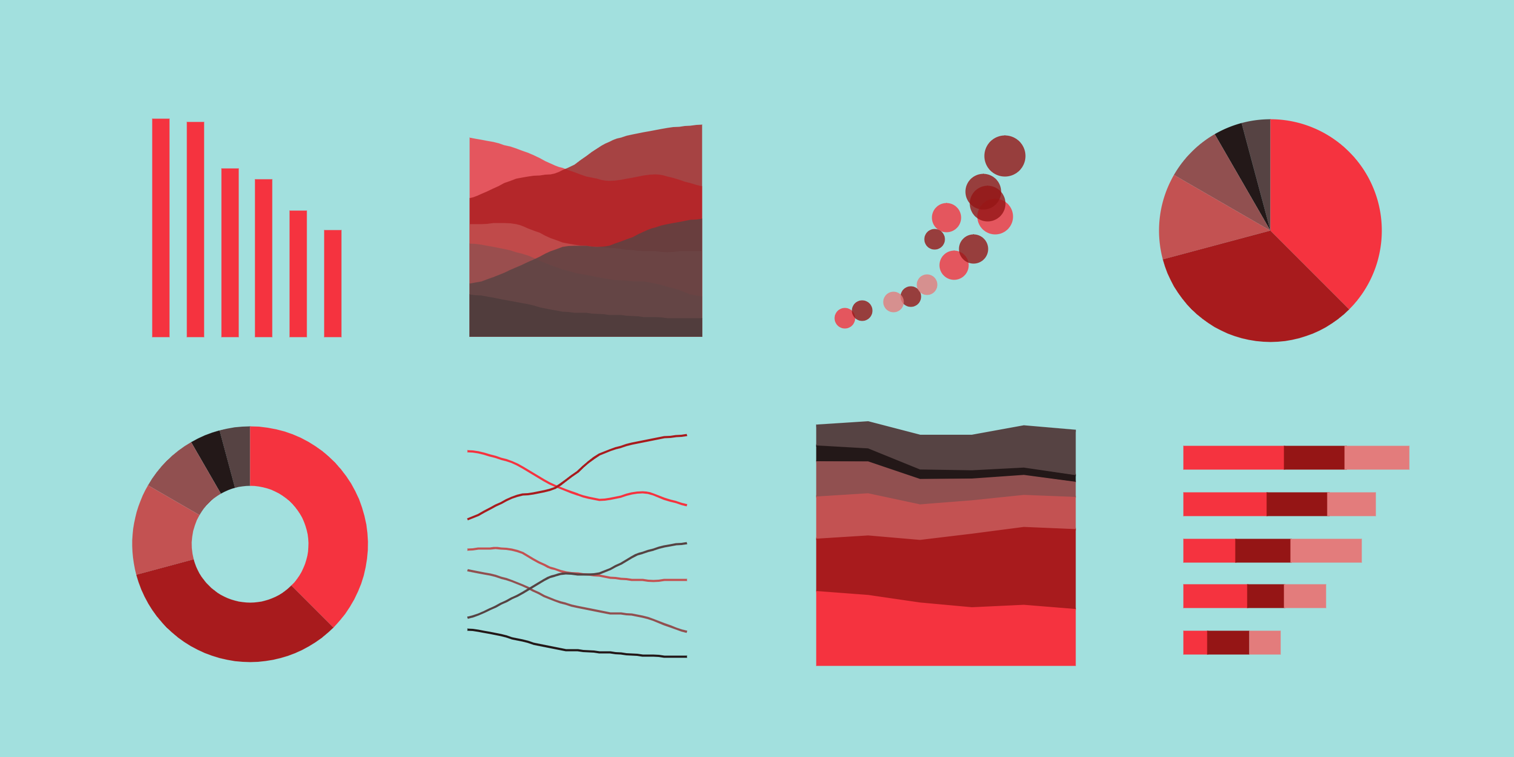
Stunning Visualization Gear Visualizing and Animating Data
Lucas Jellema –
Conclusion Code Café, Donderdag 29 april 2021
sources: https://github.com/lucasjellema/code-cafe-intro-to-svg

Slide 2
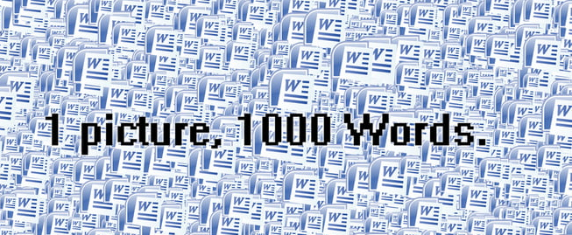
One Picture > 1000 words

Slide 3
Turning Data into Something Visual
As a backend person
Dealing in Data
How do I create a visual representation
representative
appealing
interactive
animated
In an easy way?

Slide 4
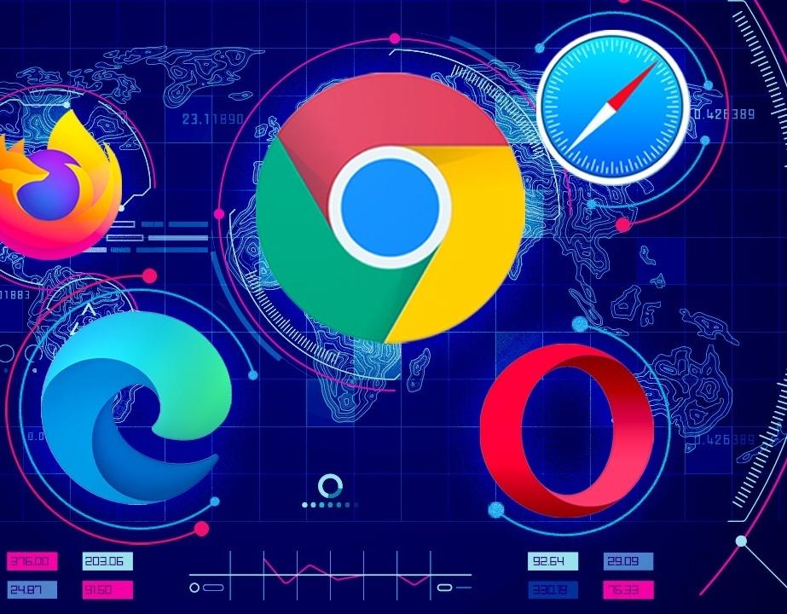
Power of the Browser
Omnipresent application platform
Leverages host system (to the fullest)
Built-in
Rich UI rendering
User Interaction & Client event handling
Storage
Networking & HTTP
Development support (debug, profile)
Fast (on a human scale)

Slide 5







HTML
CSS
image & media
SVG
Browser
Media
Text
Forms
components
Images
Graphics
Navigation
(hyperlinks)

Slide 6

Scalable Vector Graphics
XML-based language for 2-dimensional Vector Graphics (shapes, not pixels)
W3C standard – initial release 2001 (SVG 1.1 released in 2011)
Full render support in all browsers
Integration with HTML, JavaScript & CSS
“SVG is to graphics what HTML is to text”
Many graphical editors/drawing tools support creation of SVG documents
draw.io (now diagrams.net) is powered by SVG
and can create SVG documents

Slide 7
Draw Shapes
Line, Circle, Ellipse, Rectangle, Polygon
<svg width="500" height="500">
<shape shapeAttribute1="value" shapeAttribute2="value" style="style settings" />
</svg>

Slide 8

Rectangle
<svg width="500" height="500">
<rect width="300" height="100" />
</svg>

Slide 9
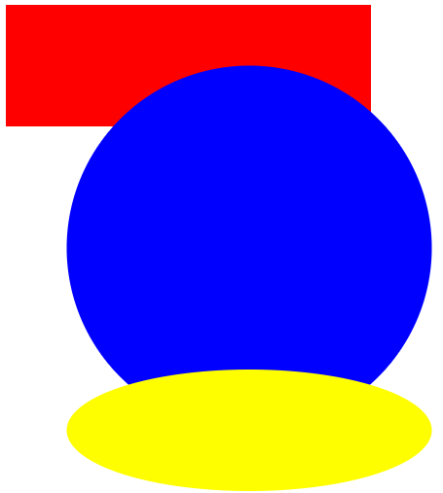
Multiple, colorful shapes
<svg width="500" height="500">
<rect width="300" height="100" style="fill:red" />
<circle cx="200" cy="200" r="150" style="fill:blue" />
<ellipse cx="200" cy="350" rx="150" ry="50" style="fill:yellow" />
</svg>

Slide 10
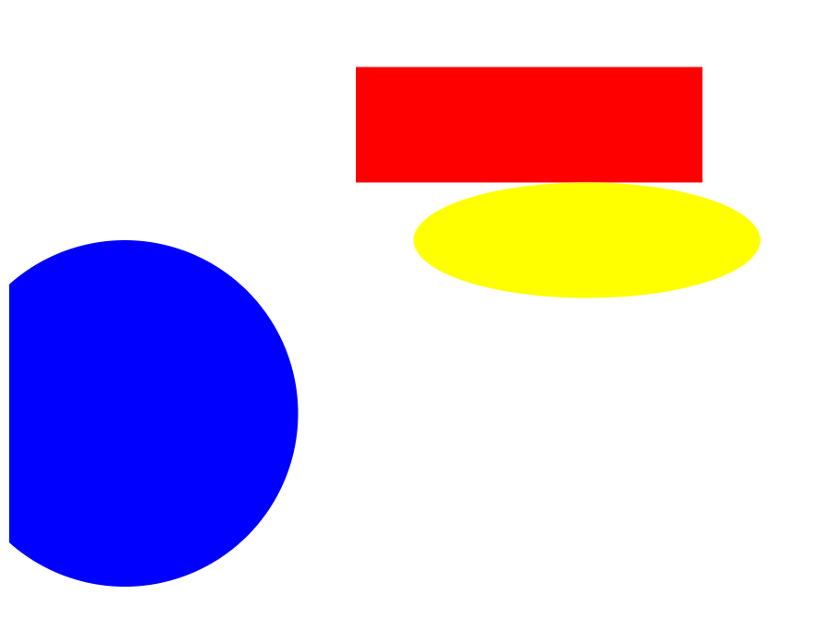
Positioning Shapes
<svg width="500" height="500">
<rect width="300" height="100" style="fill:red" transform="translate(300, 50)"/>
<circle cx="200" cy="200" r="150" style="fill:blue" transform="translate(-100, 150)"/>
<ellipse cx="200" cy="350" rx="150" ry="50" transform="translate(300, -150)"/>
</svg>
Shapes can be “transformed”

Slide 11
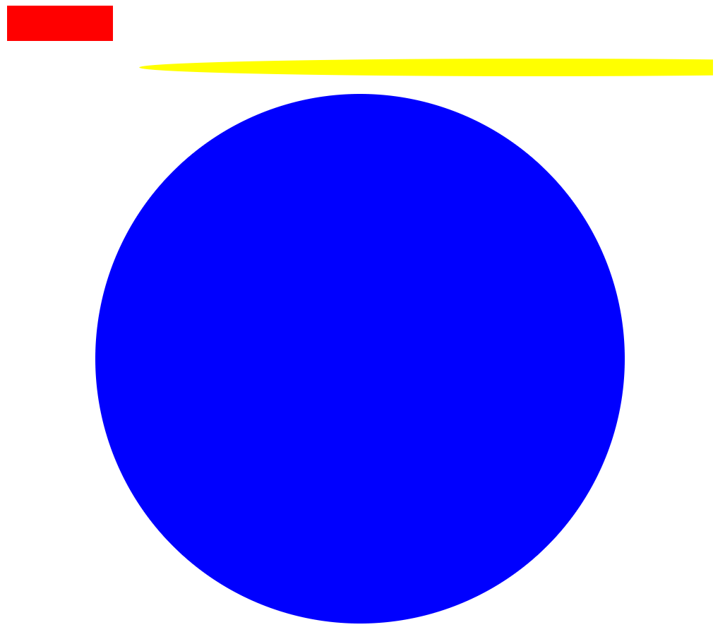
Scaling Shapes
<svg width="500" height="500">
<rect width="300" height="100" style="fill:red" transform="scale(0.4)"/>
<circle cx="200" cy="200" r="150" style="fill:blue" transform="scale(2)"/>
<ellipse cx="200" cy="350" rx="150" ry="50" transform="scale(3,0.2)"/>
</svg>
Shapes can be “transformed”

Slide 12

Animating Shape properties
<svg width="800" height="800">
<rect width="300" height="100" style="fill:rgb(81, 0, 255)" >
<animate attributeName="width" attributeType="XML" begin="0s" dur="6s" fill="freeze"
from="300" to="800" />
<animate attributeName="fill" attributeType="CSS"
begin="2s" dur="4s" fill="freeze"
from="lime" to="red" />
</rect>
</svg>

Slide 13
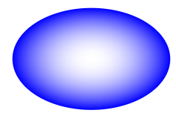

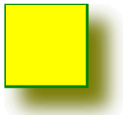


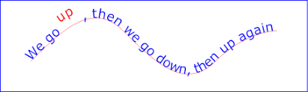

Additional Features
Color gradients
Shadow
Blur
Filter
Text on curved path
Mask and Clipping
Foreign Objects
embed HTML in SVG
SVG Sprits

Slide 14
Programmatic SVG – using D3.js
D3 = Data Driven Documents
D3.js is a JavaScript library for producing dynamic, interactive data visualizations in web browsers. It makes use of SVG, HTML5, and CSS standards.
initial release: 2011
D3 allows simple, programmatic manipulation of SVG

Slide 15
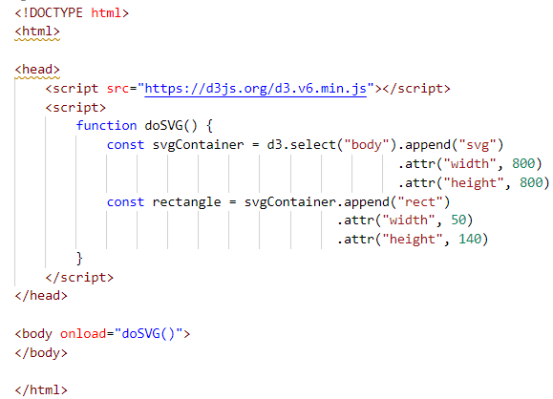
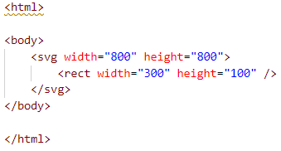

Dynamically & Programmatically Manipulating SVG

Slide 16
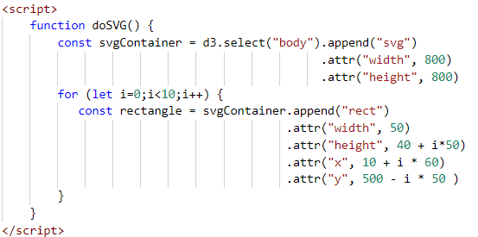
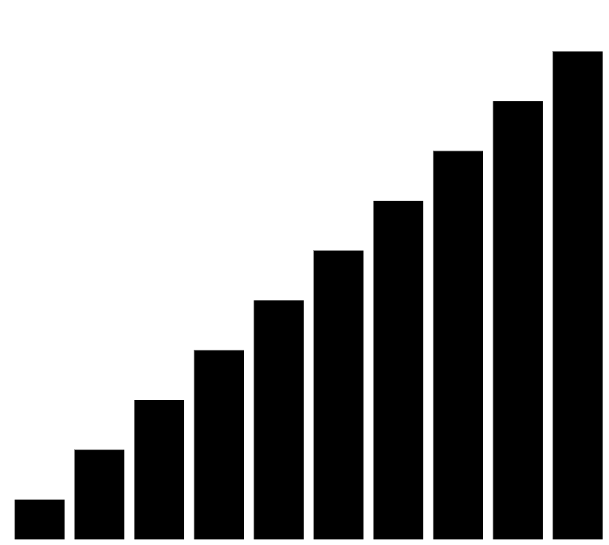
Dynamically & Programmatically Manipulating SVG

Slide 17

Quick Response
Use slider to set size
Use color input control to set color

Slide 18
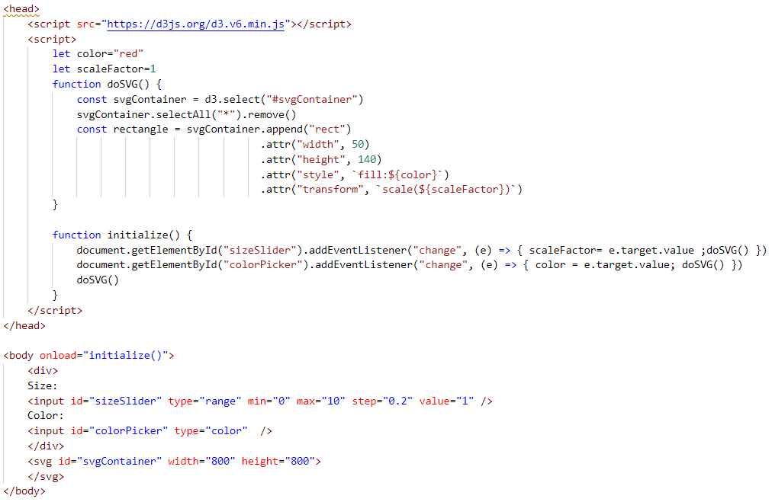
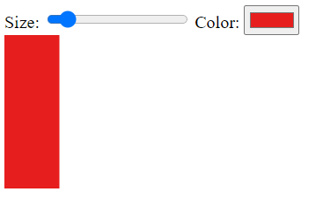
Quick Response – process every change in controls => SVG

Slide 19
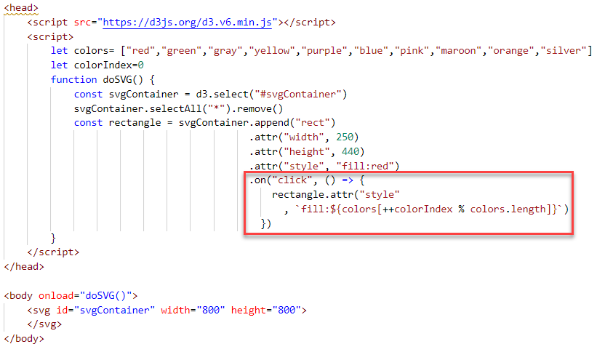
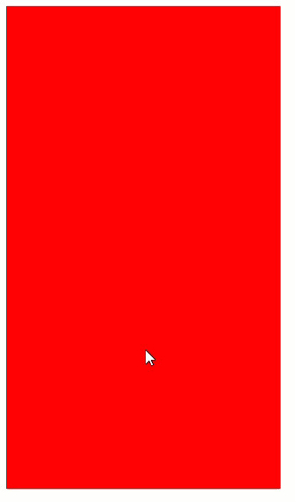
Interactivity – handle click on SVG object also: double click, mouse over, mouse out, mouse down, mouse up, contextmenu

Slide 20
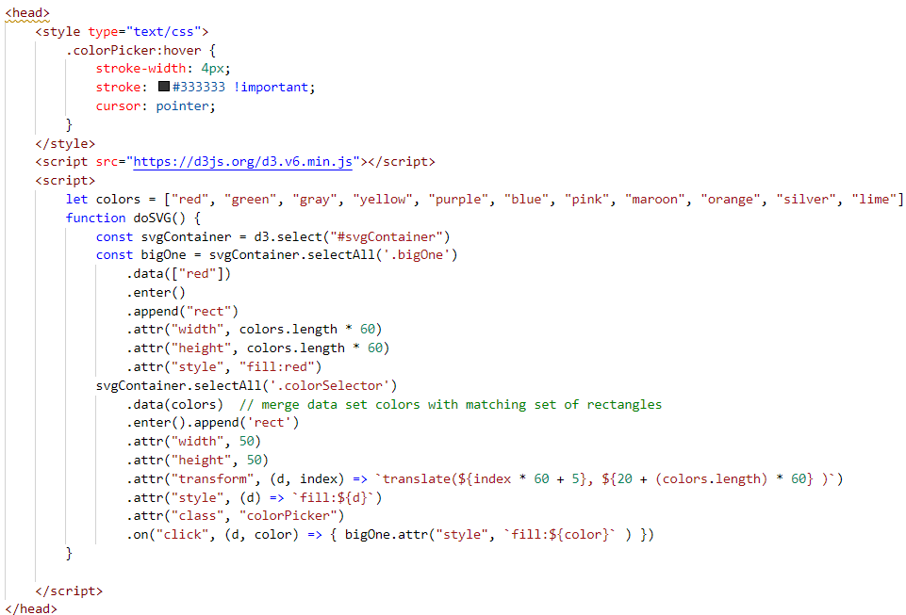

Generate SVG Shapes to Match Data Set

Slide 21
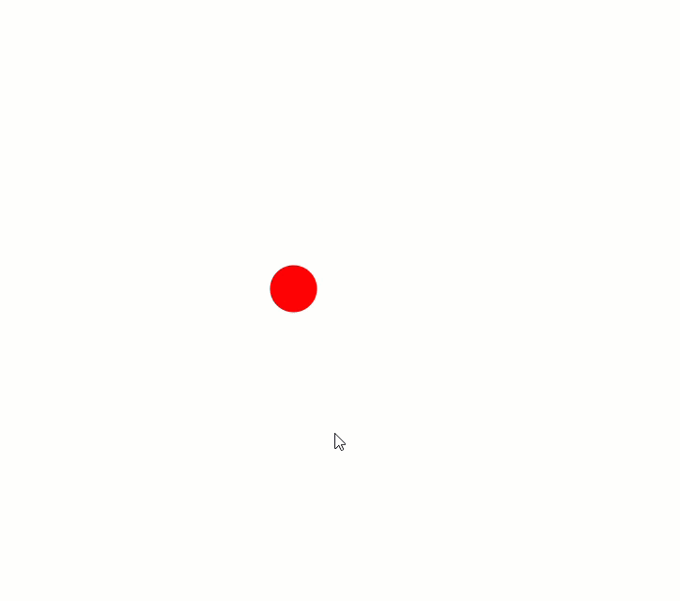
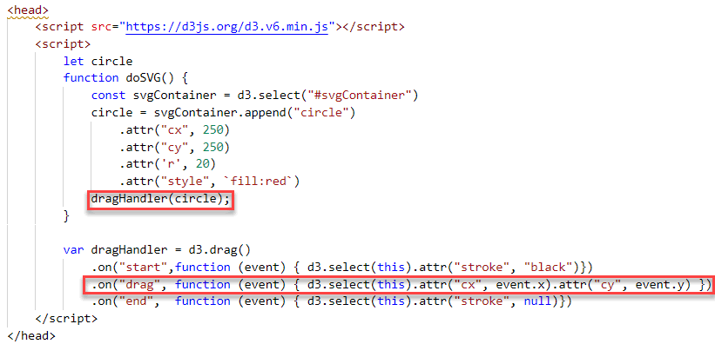
Drag & Drop

Slide 22
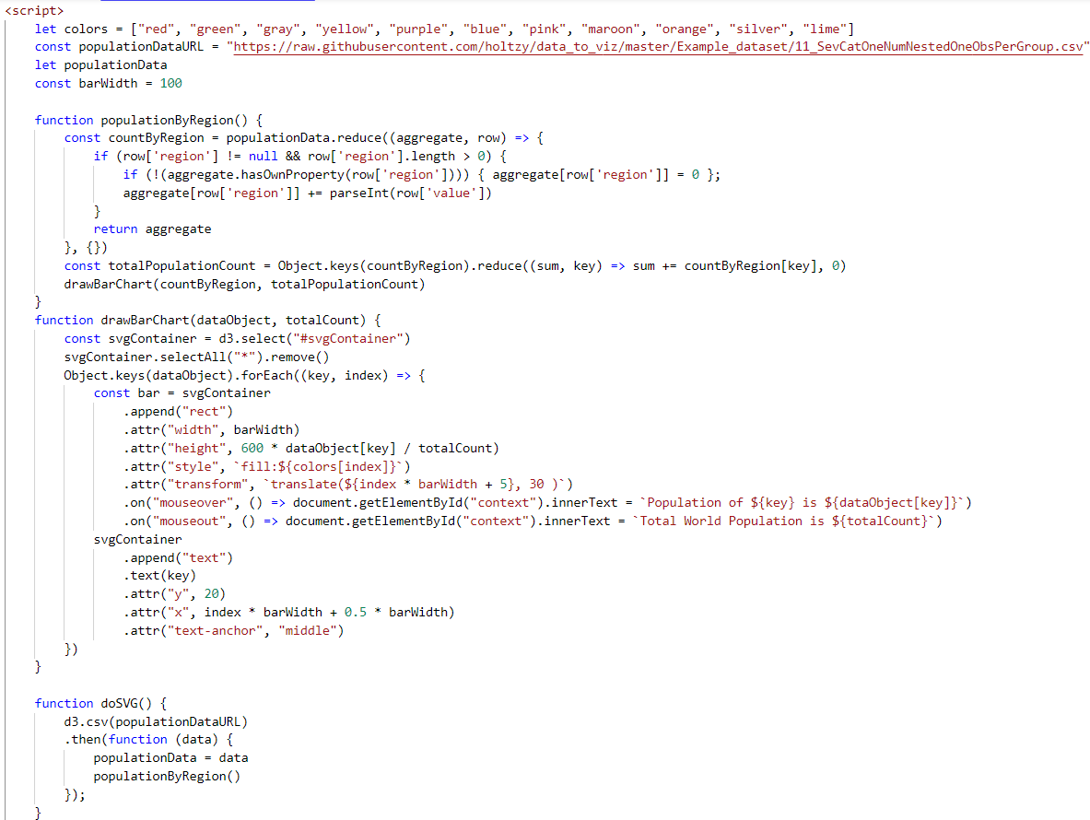
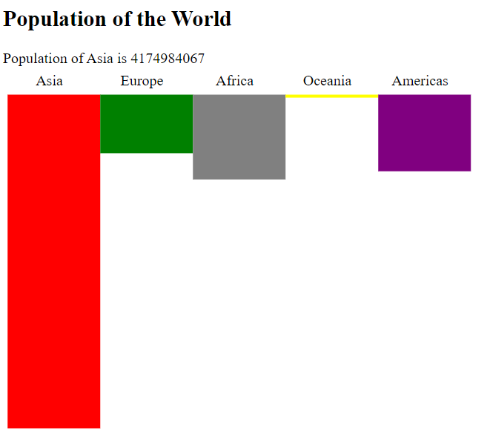
Barchart from CSV data
Aggregate into shape
Draw Bar per Region
Print Text Label per Region
Fetch Data

Slide 23
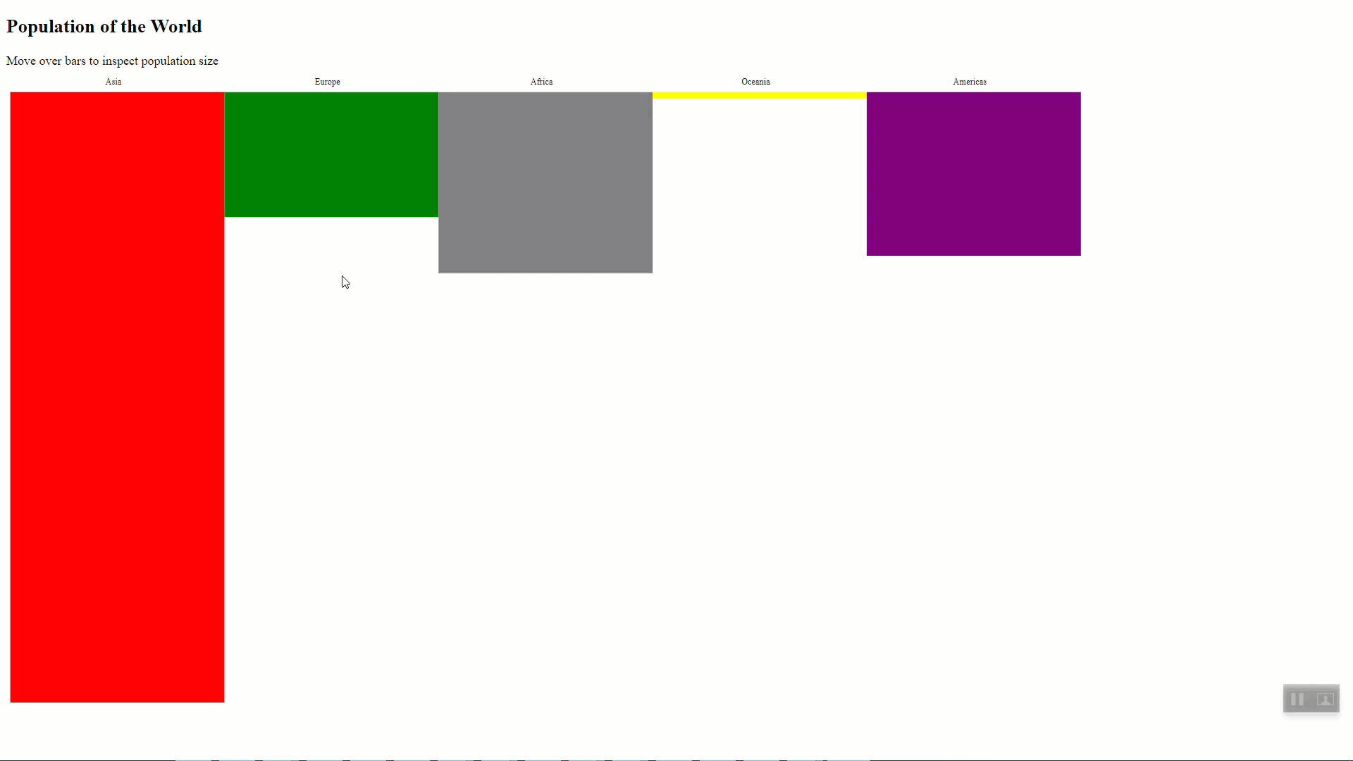
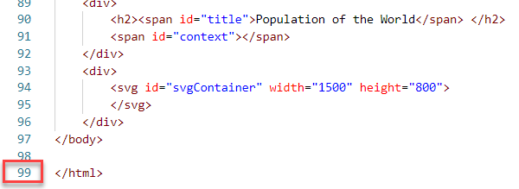
Barchart with Drilldown

Slide 24
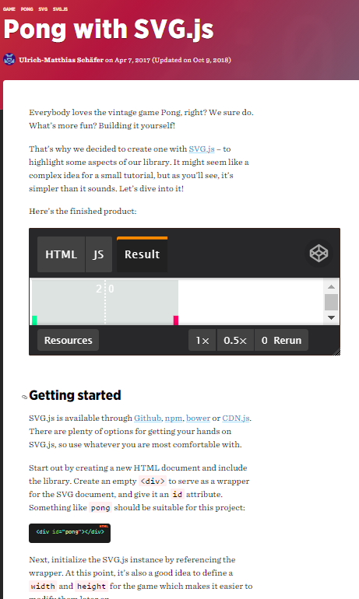
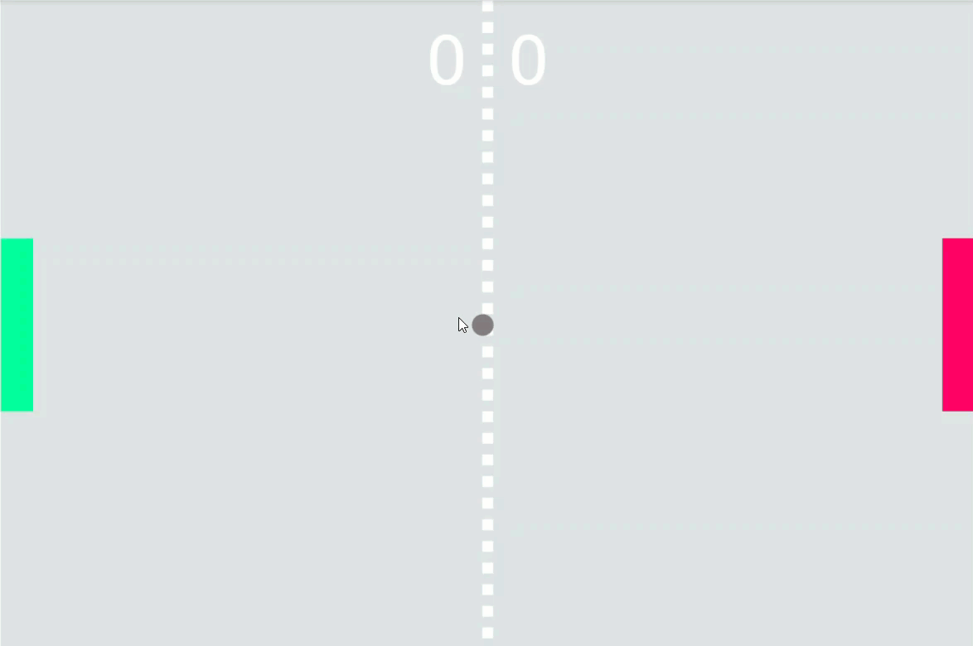
Pong
200 lines of code
https://css-tricks.com/pong-svg-js/
Notes:
https://css-tricks.com/pong-svg-js/
https://codepen.io/wout/pen/WpzNVE

Slide 25
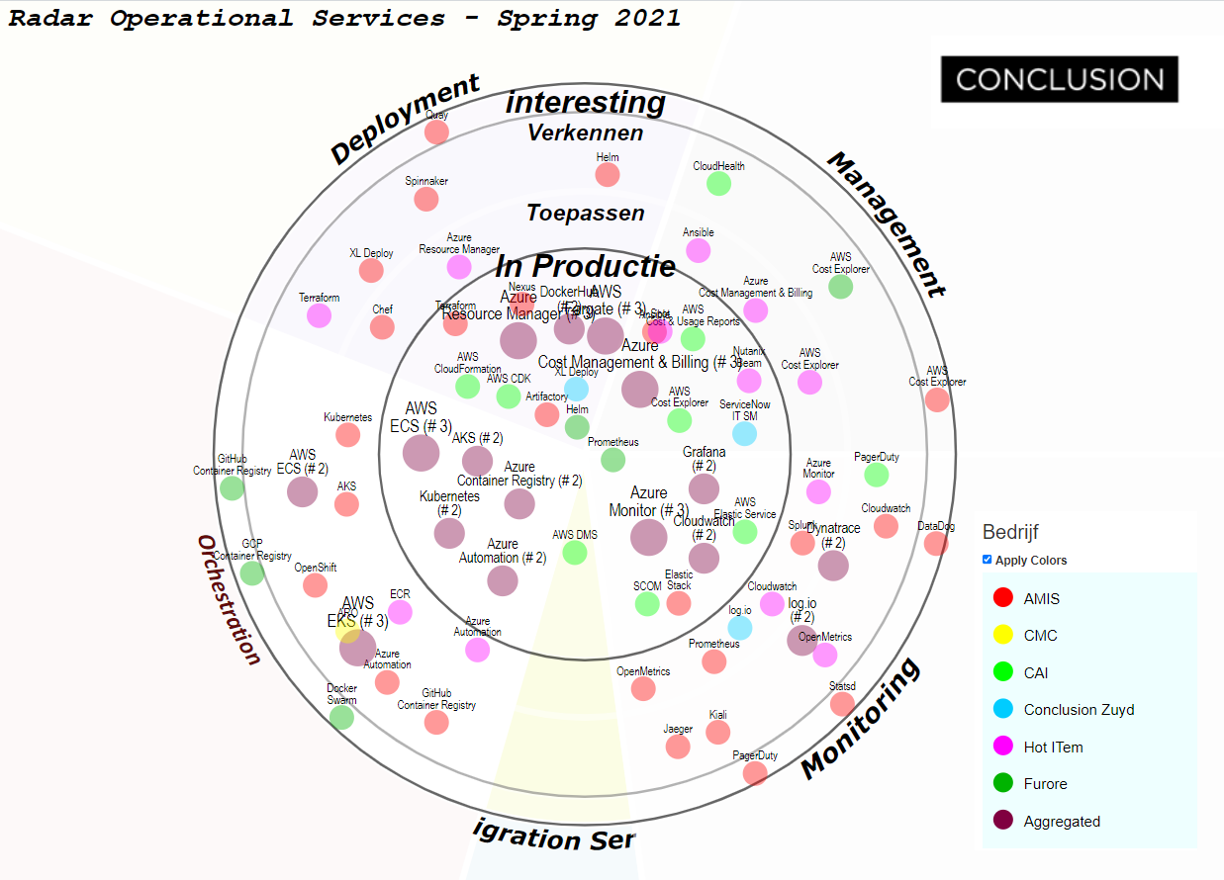
Radar

Slide 26
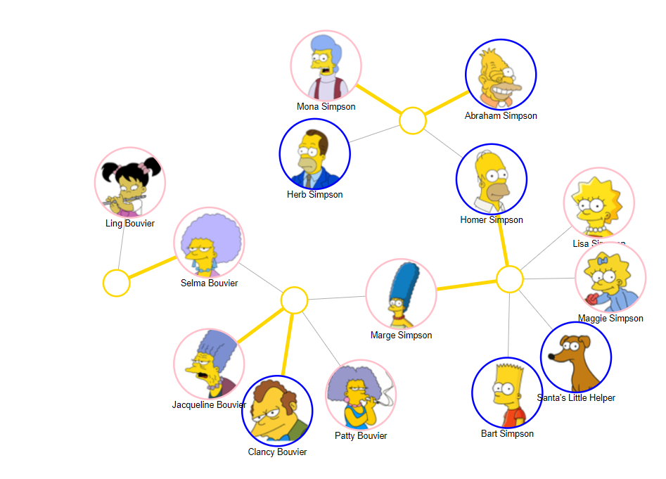
D3 Force Graph
source: http://bmdata.co.uk/simpsons/

Slide 27
Conclusion
Turn Data (CSV, JSON, XML, …) into Graphics
Easy Scale/Zoom
Simple Interaction (click, drill, drag, hover)
Color, Opacity/Transparency, Gradient, Fill Patterns, Mask/Clip
Animation/Transition – rapid full redraw or simple animation of attributes
Supported by all browsers
Using D3 library makes life even easier
sources: https://github.com/lucasjellema/code-cafe-intro-to-svg

